Slide 1
Module 6: IO Streams

Slide 2
IO streams
In Java, I/O streams are used to handle input and output operations. They provide a convenient way to read and write data to and from different sources
An input stream is used to read data from the source.
An output stream is used to write data to the destination.

Slide 3
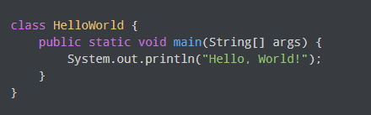
IO streams
Output Stream

Slide 4
Types of streams
Byte Stream
Byte stream reads and writes a single byte (8 bits) of data.
All byte stream classes are derived from base abstract classes called InputStream and OutputStream.
Character Stream
Character stream is used to read and write characters of data.
All the character stream classes are derived from base abstract classes Reader and Writer.

Slide 5
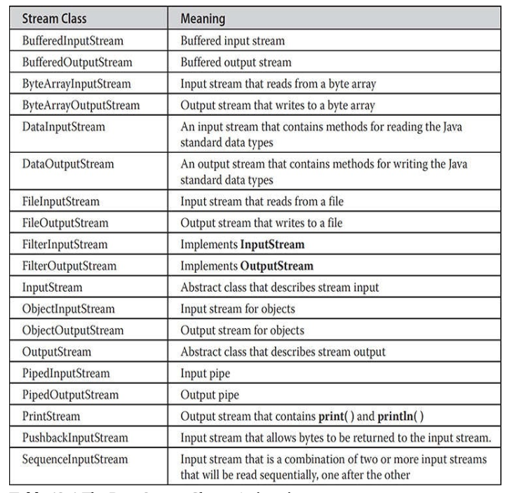
Byte Streams

Slide 6
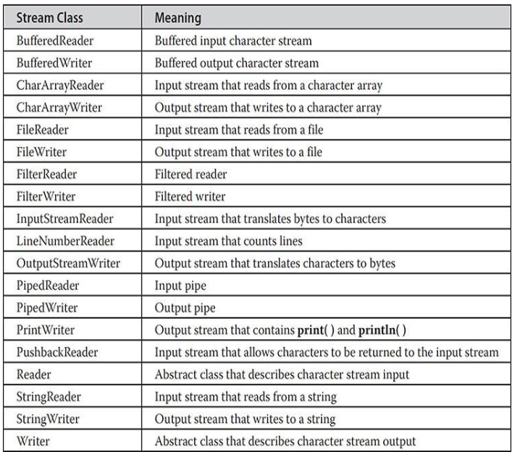
Character Streams

Slide 7
Java provides various classes in the java.io package to work with I/O streams. Some commonly used classes for I/O operations include:
InputStream and OutputStream for reading and writing raw binary data.
Reader and Writer for reading and writing character data.
FileInputStream and FileOutputStream for reading and writing from files.
BufferedReader and BufferedWriter for efficient reading and writing of text from character streams.

Slide 8
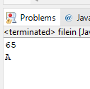
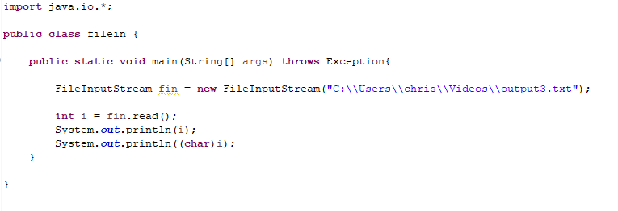
File input stream

Slide 9
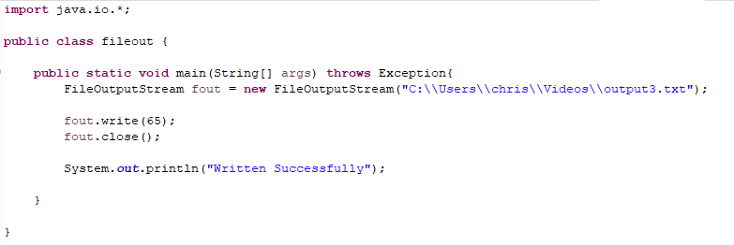
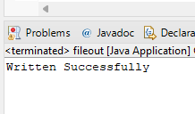
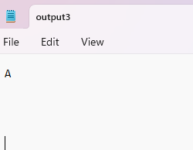
File output stream

Slide 10
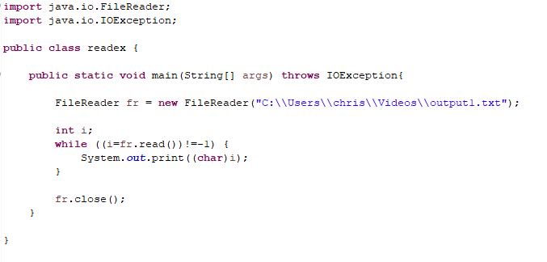
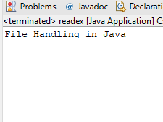
File reader

Slide 11
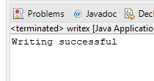
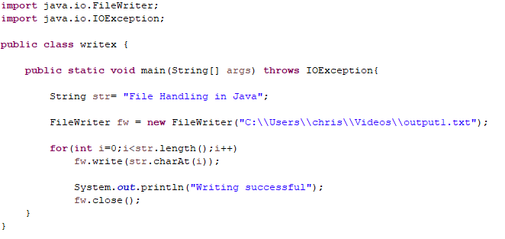
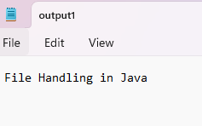
File writer

Slide 12
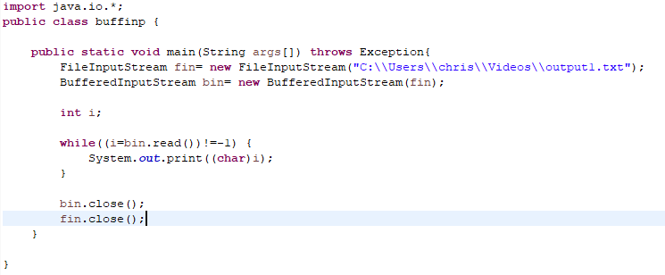

Buffered input stream

Slide 13
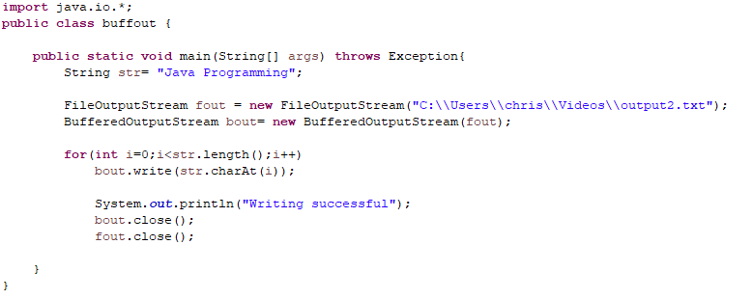
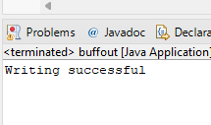
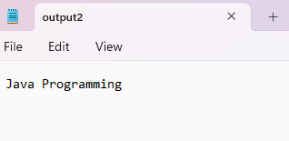
Buffered output stream

Slide 14
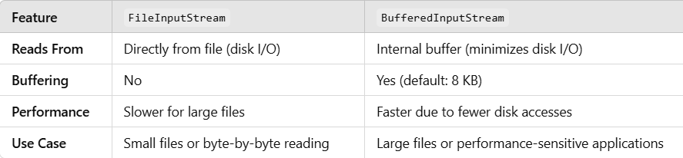

Slide 15
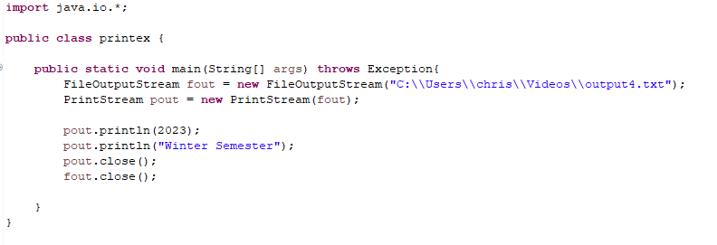
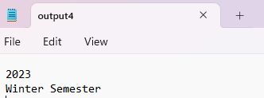
Print output stream

